Slide 1
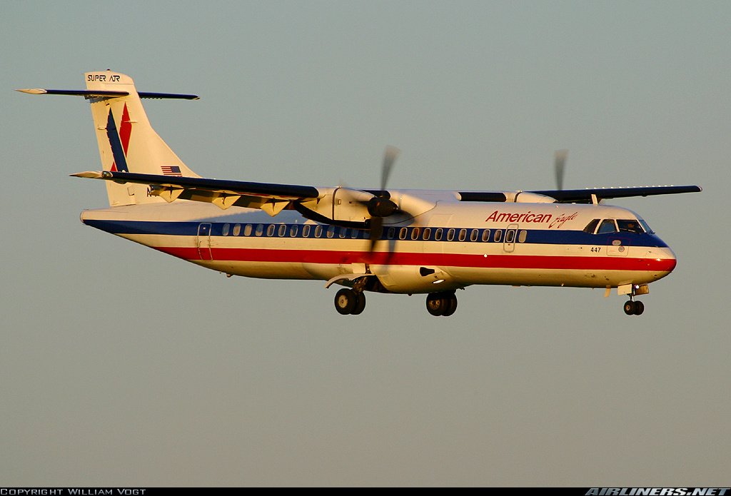
VII. Propeller aircraft performance
Notes:
VII - <number>
Issue 1 – Feb 2011
VII– Propeller aircraft performance
Propeller has been the first mean of propulsion for airplanes and the only one until the advent of jet engines in the 1940’s.
Piston engines are still widely used for light airplane propulsion while turboprops are preferred for light business, commuters or utility airplanes and for some military airplanes such as basic trainers, maritime patrol airplanes and tactical transports.
Most current propeller airplanes cruise at low Mach numbers (below 0.5), but some fast turboprops, such as military trainers, have maximum speeds over Mach 0.70.
Illustration : ATR 72 twin turboprop regional transport

Slide 2
1. Propeller propulsion
Engine
Vj
V
Notes:
VII - <number>
Issue 1 – Feb 2011
VII– Propeller aircraft performance
Propellers are usually driven by reciprocating engines or turbines (turbo propellers). Electric motors powered by solar cells have been used in experimental unmanned vehicles (human power has also been used on very light aircraft).
Most reciprocating engines are not geared : the propeller is directly driven by the crankshaft, as a consequence, propeller rotates at engine rotation rate. This requires engines with a relatively low maximum rotation speed (usually less than 3000 rpm) when compared to automotive engines.
Compared to jet engines, the main characteristics of propellers are :
A large diameter, with a relatively low exhaust velocity (Vj).
Good propulsive efficiency (consequence of low exhaust velocity).
High vibration levels (consequence of large diameter).

Slide 3
1. Propeller propulsion
Good propulsive efficiency : low fuel consumption.
May be driven by a reciprocating engine or a turbine (turboprop).
Blade tip Mach number limits speed to subsonic range.
Adapted to light airplanes.
Notes:
VII - <number>
Issue 1 – Feb 2011
VII– Propeller aircraft performance
The propeller is well suited to light aircraft propulsion, with low cruise speeds :
it has a good propulsive efficiency, leading to good fuel economy,
low power reciprocating engines may be built at relatively low costs (for light and ultra light airplanes).
Propeller airplanes are limited to subsonic flight : when tip blade Mach number becomes supersonic, shock waves develop with negative consequences in terms of efficiency, vibrations and noise levels.
Due to this Mach number limitation, turbojets and turbofans have replaced propellers for combat aircraft propulsion, as well as for commercial airplane propulsion.

Slide 4

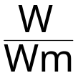
1. Propeller propulsion
The propeller
V
Propeller advance ratio
=
Vc
Ω
Γ
D
F
Ω = 2πN
Propulsive power : W = V.F
Shaft power : Wm = Ω.Γ
Propeller efficiency : η_{H} =
(constant rpm)
Notes:
VII - <number>
Issue 1 – Feb 2011
VII– Propeller aircraft performance
At a given propeller section (defined by its radius from the propeller axis, noted r). Relative airspeed is the vector addition of airspeed and speed induced by blade rotation :
Relative true airspeed is a function of true airspeed, propeller advance ratio γ, and relative section position :
Propeller rotation speed Ω, results from balance between shaft power Wm (input power) and power absorbed by the propeller W_{H}. At equilibrium (constant rotation speed), shaft power equals power absorbed by the propeller (J is the propeller inertia):
Propeller efficiency is the ratio between the propulsive power (output power : thrust multiplied by true airspeed) and power absorbed by the propeller W_{H}. At constant rotation speed, propeller efficiency is the ratio between propulsive power and shaft power.

Slide 5
1. Propeller propulsion
Forces acting on a propeller blade section
  ϖ is the propeller blade angle
dZ
dF
  α_{b}
Vr
  ϖ
dR
dX
Vr
V
Vc
α_{b} is the blade angle of attack
Notes:
VII - <number>
Issue 1 – Feb 2011
VII– Propeller aircraft performance
Local angle of attack of a blade section is a function of its relative position, its angle and blade advance ratio :
Elementary forces and moments on a blade section located at a distance r from propeller hub are detailed below. In blade aerodynamic reference system, elementary lift is dZ and elementary drag is dX with :
dZ = ½ ρ V_{R}² l_{b} Cz_{b} dr dX = ½ ρ V_{R}² l_{b} Cx_{b} dr
Drag and lift coefficients Cx_{b} and Cz_{b} are functions of local blade angle of attack α_{b} and of local Mach number.
Elementary contributions to propeller thrust and power absorbed by propeller are :
dF = cos(ϖ(r) - α_{b}) dZ - sin(ϖ (r) - α_{b}) dX
dW_{H} = (cos(ϖ (r) - α_{b}) dX + sin(ϖ (r) - α_{b})dZ ) Ω . r
Blade is twisted so as to optimize loading as function of section relative position : blade angle ϖ is a function of blade section location (ϖ =ϖ(r)).
To define blade characteristics (blade angle ϖ and blade angle of attack α_{b}), a typical blade section, usually located at 70 % (r = 0.70 R), is often used.
At zero advance ratio (ground run-up), blade angle of attack equals blade angle. When advance ratio increases, blade angle of attack decreases.

Slide 6

1. Propeller propulsion
Non dimensional coefficients for propeller performance
Traction coefficient τ : F = ρ N² D⁴ τ
Power coefficient χ : W_{H} = ρ N³ D⁵ χ
  W_{H} is the power absorbed by the propeller
  At constant rpm : W_{H} = Wm
Propeller efficiency : η_{H} = τ γ / χ
Non dimensional coefficients are functions of :
  Propeller advance ratio γ = V/N.D
  Propeller blade angle ϖ
  Blade tip Mach number Mtip = M
Notes:
VII - <number>
Issue 1 – Feb 2011
VII– Propeller aircraft performance
Propeller is an aerodynamic force, which may be expressed as a function of relative true airspeed V_{R}, air density ρ and reference area S_{REF}, and an aerodynamic coefficient, noted C_{thrust} :
Relative speed at typical blade section may be expressed as a function of rotation speed N and advance ratio γ :
Reference surface is proportional to the square of diameter N².
This leads to the definition of traction coefficient. A similar expression may be derived for power absorbed by the propeller, using aerodynamic moment definition (blade diameter is used as reference length) and expression for rotation rate.
Propeller blade angle ϖ is the reference section blade angle : blade angle at 70 % radius location (0.70 R).

Slide 7
1. Propeller propulsion
Propeller efficiency
Propeller
efficiency
η_{H}
Increasing blade angle ϖ
Optimal
efficiencies line
ϖ₁
ϖ₂
ϖ₃
Advance ratio γ
For low Mtip values, efficiency is a function of blade angle and advance ratio.
On « constant speed » propellers, blade angle varies, so as to maintain efficiency close to optimum.
When Mtip increases towards 1, propeller efficiency decreases.
Notes:
VII - <number>
Issue 1 – Feb 2011
VII– Propeller aircraft performance
Propeller efficiency is zero at run-up, since propulsive power is zero at zero airspeed (from the non-dimensional expression, η_{H} is zero when γ is zero).
When airspeed (or advance ratio) increases, propeller efficiency increases up to a maximum value, then decreases, reaching negative values.
Blade angle of attack (at reference section) is maximum for zero advance ratio, then decreases. The maximum value for propeller efficiency corresponds to an optimum value of blade angle of attack. When advance ratio increases, blade angle of attack becomes negative and thrust may become negative.
When propeller angle increases, blade angle of attack at zero advance ratio increases. As a consequence :
Advance ratio for maximum efficiency increases.
Power coefficient for zero advance ratio increases.
On fixed pitched propellers (constant blade angle), power equilibrium is achieved through rotation speed : when power absorbed by propeller is higher than shaft power, rotation speed decreases until equilibrium is achieved.
On fixed constant speed propellers (variable blade angle), power equilibrium is achieved through blade angle : when power absorbed by propeller is higher than shaft power, blade angle decreases until equilibrium is achieved (when blade angle decreases, power coefficient decreases).
When tip Mach number increases, local drag increases on outer blade sections (and lift decreases), leading to higher power coefficient and lower efficiency.

Slide 8
1. Propeller propulsion
Propeller engine performance
Engine performance defines shaft power Wm.
Maximum power variations with speed :
W(V) = ηH(γ) . Wm (V)
As a first approximation, shaft power may be considered as constant : maximum power varies according to propeller efficiency.
Shaft power may be limited by :
  Mechanical limitations (maximum torque, max. rpm).
  Thermodynamic limitations (turbine inlet temperature, fuel air ratio).
Notes:
VII - <number>
Issue 1 – Feb 2011
VII– Propeller aircraft performance
Maximum power evolution with airspeed
Shaft power evolutions with airspeed are limited : for a reciprocating engine, shaft power does not depend on airspeed while for a turbine shaft power may increase with airspeed, at low speeds, due to the increase in ram air pressure.
Propeller efficiency is a function of airspeed (advance ratio decreases when airspeed increases), which has an impact on maximum propulsive power.
As a first approximation, we may consider that propulsive power evolution with speed is dictated by propeller efficiency.
Maximum shaft power, evolution with altitude and temperature
Mechanical limitations are:
maximum rpm,
maximum torque (for turboprops)
maximum manifold pressure (for reciprocating engines).
Thermal limitations are :
for turboprops, turbine inlet temperature (or other temperature parameters such as inter stage temperature or exhaust gases temperature),
for reciprocating engines, power is limited by the fuel-air ratio, maximum power is obtained when fuel air ratio reaches its optimum value.

Slide 9
1. Propeller propulsion
Evolution of maximum shaft power with altitude
Turboprop
Atmospheric reciprocating engine
Pressure
altitude
Zp
Thermal
Limitation
ISA
ISA + 10°
Pressure
altitude
Zp
ISA + 10°
ISA
Mechanical
limitation
Maximum shaft power
Maximum shaft power
Notes:
VII - <number>
Issue 1 – Feb 2011
VII– Propeller aircraft performance
The above slide presents maximum shaft power evolution with pressure altitude.
In the case of a turboprop (left sketch) shaft power is usually limited by mechanical limitation (max. torque and rpm) at low altitude and by thermal limitation at higher altitude. :
Mechanical limitation corresponds to a maximum power independent from altitude and temperature (corresponding to maximum values for torque and rpm).
Thermal limitation decrease with altitude (as a first approximation, thermal limitation is proportional to air density) : a constant internal temperature corresponds to a lower fuel flow value when air density decreases (a temperature increase has similar consequences).
In the case of an atmospheric engine, the maximum power decreases when altitude or temperature increases, since power is limited by fuel air ratio.
In the case of a turbocharged engine, maximum shaft power evolution with altitude and temperature, is similar to maximum turboprop power evolution (however, at constant manifold pressure, there is a small power decrease when altitude increases due to a compression ratio increase, which increases inlet temperature).

Slide 10
1. Propeller propulsion
Specific fuel consumption
For a propeller engine, specific fuel consumption (SFC) is the fuel flow to shaft power ratio :
Ch = Cs.Wm = Cs.W/ηH
    Ch : fuel flow (kg/h)
    Cs : SFC (kg/kW/h)
    Wm : shaft power (kW)
Order of magnitude for SFC :
0.30 kg/kW/h (or 0.5 lb/SHP/h)
Notes:
VII - <number>
Issue 1 – Feb 2011
VII– Propeller aircraft performance
Specific fuel consumption is a function of operating conditions.
In the case of a turboprop, optimum SFC is reached when shaft power is close to the thermodynamic limitation (evolution is similar to jet engines evolution).
In the case of a reciprocating engine, optimum SFC is reached for the rpm corresponding to maximum torque.
Note : Specific Fuel Consumption definition for jet engines is different from the above definition for propeller engines.

Slide 11
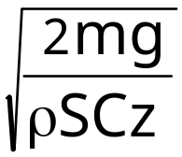
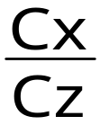
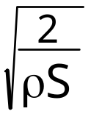
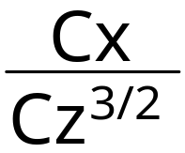
2. Power required for level flight
Power required for level flight
Power required for level flight
Wn = V.Fn = ½ρV³ S Cx
V = Lift equation
Fn = mg
Wn = (mg)^{3/2}
Notes:
VII - <number>
Issue 1 – Feb 2011
VII– Propeller aircraft performance
Power required for level flight (sometimes called « power required »), is the propulsive power required to maintain straight and level flight at constant airspeed (assuming constant wind).
The above expression for power is derived from the expressions for thrust required and true airspeed, as functions of mass, air density and aerodynamic coefficients.
In the case of a propeller airplane, in steady straight and level flight, shaft power is a function of power required and propeller efficiency :

Slide 12
2. Power required for level flight
Incompressible drag polar
influence of mass and air density
Constant lift coefficient Cz ⇒ Cx = Cx(Cz)
Influence of mass m
  TAS & EAS proportional to √m
  Thrust required proportional to m
  Power required proportional to m3/2
Influence of air density ρ
  TAS proportional to 1/√ρ
  EAS independent from ρ
  Thrust required independent from ρ
  Power required proportional to 1/√ρ
Notes:
VII - <number>
Issue 1 – Feb 2011
VII– Propeller aircraft performance
True airspeed, equivalent airspeed, thrust required and power required may be expressed as functions of lift and drag coefficients, mass and air density :
Assuming an incompressible drag polar, for a given lift coefficient Cz, drag coefficient is constant and does not depend on airspeed. From the above expressions, we can thus derive the influences of mass and air density on V, EV, Fn and Wn (assuming constant lift coefficient).

Slide 13
2. Power required for level flight
Power diagram (propeller airplane)
Power
W
Power required Wn
Maximum propeller
power Wu
Propeller power for intermediate lever angle τ
min. Wn/V
min. Wn
Stall
Max.
L/D
V_{H}
max. TAS
level flight
True Airspeed
V
Min.
Cx/Cz^{3/2}
idle power
Notes:
VII - <number>
Issue 1 – Feb 2011
VII– Propeller aircraft performance
Power diagrams present power required Wn and propulsive power as functions of airspeed. A power diagram is valid for given airplane mass, altitude and temperature.
This diagram is mainly used for propeller airplanes : at given altitude and temperature, propeller thrust is a function of airspeed and power lever angle. It varies from idle power to maximum power.
On the power required versus speed curve, 4 points are marked :
Stall speed.
Minimum power required, corresponding to the minimum value for Cx/Cz^{3/2}.
Minimum power required over airspeed ratio, corresponding to maximum L/D. Assuming constant specific fuel consumption and propeller efficiency, this speed allows for maximum range.
V_{H} : maximum true airspeed in horizontal flight. At V_{H}, maximum propulsive power equals power required for level flight. Usually, for propeller airplanes, VH is lower than maximum operating speeds corresponding to structural limitations.
Remarks :
At higher speeds, propulsive power is negative at idle power, due to negative propeller efficiency.

Slide 14
2. Power required for level flight
Drag polar and thrust / power diagrams
Cz
Stall
Cz_{max}
Cz₂
Min Cx/Cz^{3/2} ⇒ Min. Wn
Cz₁
Max L/D ⇒ Min. Fn / Min. Wn/V
Cz₃
Min Cx/Cz^{1/2} ⇒ Min. Fn/V
Cx
Notes:
VII - <number>
Issue 1 – Feb 2011
VII– Propeller aircraft performance
This figure presents particular points on an incompressible drag polar :
Stall speed corresponds to the maximum lift coefficient Cz_{max}.
Lift coefficient for maximum L/D, noted Cz₁, corresponding to minimum thrust required and minimum power required to speed ratio.
Lift coefficient for minimum Cx/√Cz, noted Cz₃, corresponding to the minimum thrust required to speed ratio.
Lift coefficient for minimum Cx/Cz^{3/2}, noted Cz₂, corresponding to the minimum value for power required.
In the case of a symmetrical drag polar (Cx = Cx₀ + k Cz²) :
Note 1 : If the influence of Mach number on drag coefficient is not negligible, this is no longer valid since Mach number varies along with speed.
Note 2 : in the case of a non symmetrical drag polar, the expressions are detailed below (Cx = Cx_{min} + k (Cz-Cz_{opt})²).

Slide 15
3. Optimum climb speeds (prop A/C)
Power
W
Power required Wn
Maximum propeller
power Wu
Max. Vz
Max. γ_{a}
Excess power
ΔW = Wu - Wn
Stall
V_{H}
max. TAS
level flight
True Airspeed
V
Min.
Cx/Cz^{3/2}
Notes:
VII - <number>
Issue 1 – Feb 2011
VII– Propeller aircraft performance
In the case of a propeller airplane, speed corresponding to optimum vertical speed is close to the speed corresponding to minimum power required : if maximum engine power is constant (does not depend on speed), maximum excess power corresponds to minimum power required required.

Slide 16
3. Optimum climb speeds (prop A/C)
For propeller airplanes, best vertical speed is obtained for a speed close to minimum power required (min. Cx/Cz^{3/2}).
Optimum climb speeds for propeller airplanes are low (compared to jet airplanes).
Notes:
VII - <number>
Issue 1 – Feb 2011
VII– Propeller aircraft performance
Based on the constant thrust approximation for a jet airplane and constant power approximation for a propeller airplane :
For a jet airplane : best climb angle is obtained at the speed corresponding to maximum lift over drag ratio, and best vertical speed is obtained at a higher speed.
For a propeller airplane : best vertical speed is obtained at the speed corresponding to minimum power required and best climb angle is obtained at a lower speed.
Since minimum power required is correspond to a speed lower than speed for best lift over drag ratio, optimum climb speeds for propeller airplanes are much lower than optimum climb speeds for jet airplanes.

Slide 17
3. Optimum climb speeds (prop A/C)
Cz
Stall
Cz_{max}
Min. Cx/Cz^{3/2}
Max. climb angle
Max. vert. speed
Propellers
Increasing Airspeed
Max. L/D
Max. climb angle
Jets
Max. vert. speed
Cx
Notes:
VII - <number>
Issue 1 – Feb 2011
VII– Propeller aircraft performance
This slide presents, on a drag polar, lift coefficients corresponding to optimum climb speeds for jet airplanes and propeller airplanes.
It must be stressed that best climb angle speed for a propeller airplane may be very close to the stall speed. As a consequence, it may not be practicable, due to an insufficient stall margin.
Considering jet airplanes, initial climb speeds (after take-off) are ussually lower than optimum climb angle speed, since they must be kept as low as possible, in order to minimize take-off field length.

Slide 18
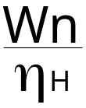
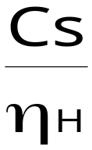
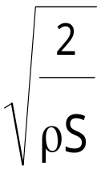
4. Propeller airplanes endurance and range
Propeller airplanes - Endurance
Fuel flow (kg/h) Ch = Cs
  Cs is the SFC (kg/W/h)
  Wn is the power required for level flight
Ch = (mg)^{3/2}
Maximum endurance ⇔ minimum fuel flow
  If specific fuel consumption Cs is constant and propeller efficiency is constant, maximum endurance is obtained at sea level (maximum air density)
Notes:
VII - <number>
Issue 1 – Feb 2011
VII– Propeller aircraft performance
Assuming constant propeller efficiency, shaft power is proportional to power required for level flight. If fuel flow increases with shaft power, it will be minimal when power required is minimal.
The airspeed corresponding to minimum power required is usually low, close to stall speed, with the following consequences :
Minimum recommended speed for holding is usually higher than speed corresponding to minimum power required, in order to guarantee adequate margin relative to stall speed (usually 1.45 Vs_{min}).
If propeller has been designed to achieve optimum efficiency in cruise (for better economics in terms of cruise speed and range), airspeed corresponding to minimum shaft power may be higher than airspeed corresponding to minimum power required.
In the case of turbine engines (turboporops), specific fuel consumption increases at low power settings. When altitude increases, power setting increases since :
Power required increases.
Maximum shaft power (thermal limitation) decreases.
As a consequence, when altitude increases, specific fuel consumption at holding speed decreases and fuel flow does not increases according to the above formula.

Slide 19
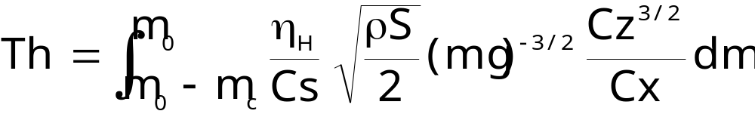
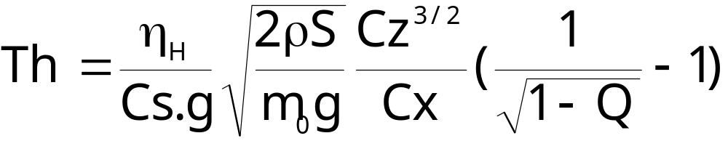
4. Propeller airplanes endurance and range
Propeller airplanes - Endurance
Endurance (in hours)
Under the following assumptions (Q is the fuel fraction) :
  Constant propeller efficiency and SFC,
  Constant lift coefficient (speed proportional to square root of mass) and incompressible drag polar,
  Constant density.
Notes:
VII - <number>
Issue 1 – Feb 2011
VII– Propeller aircraft performance
The above formula for fuel endurance is obtained assuming the following hypothesis :
Constant density : this is achieved in cruise (or while holding), maintaining level flight (constant pressure altitude), if temperature is constant.
Constant lift coefficient : this means that indicated airspeed must decrease along the time, according to fuel consumption (at a given lift coefficient, equivalent airspeed is proportional to the square root of mass, and at a given altitude, this may also be true for indicated airspeed).
Constant propeller efficiency and specific fuel consumption

Slide 20
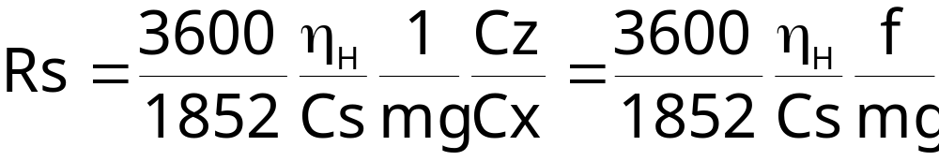
4. Propeller airplanes endurance and range
Propeller airplanes – Range
Still air specific range (in nm) :
Under the following assumptions :
  Constant propeller efficiency and SFC,
  Incompressible drag polar.
Best specific range is obtained for airspeed corresponding to best L/D (minimum drag speed) and does not depend on altitude.
Notes:
VII - <number>
Issue 1 – Feb 2011
VII– Propeller aircraft performance
From specific range definition, still air specific range is :
In the above formula, the numerical factor 3600/1852 is required to convert airspeed from meters per second to knots.
The validity of the hypothesis listed above have already been discussed in the previous slides.
In the case of turboprops, specific fuel consumption decreases when power setting increases. As a consequence, maximum specific range usually increases when altitude increases.

Slide 21
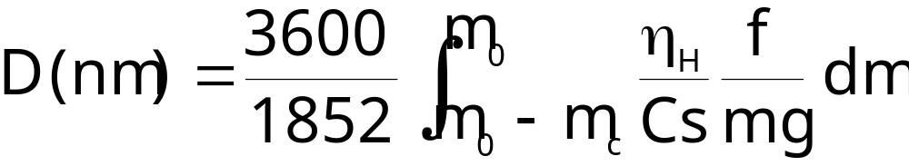
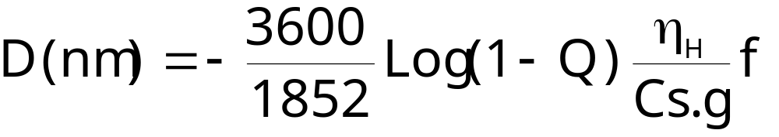
4. Propeller airplanes endurance and range
Propeller airplanes – Range
Still air range, propeller airplanes (in nm) :
Breguet’s formula for range. Assumptions :
  Constant propeller efficiency and SFC,
  Constant lift coefficient (speed proportional to square root of mass) and incompressible drag polar.
Notes:
VII - <number>
Issue 1 – Feb 2011
VII– Propeller aircraft performance
Breguet’s formula for range is a consequence of specific range expression presented in the previous slide. It assumes :
Constant propeller efficiency and SFC, which may be considered as valid, except when fuel fraction Q is high leading to speed and power variations.
Constant lift coefficient (indicated airspeed proportional to square root of mass).

